Slide 1
Convolutional Neural Networks
Technical University of Kosice
Faculty of electrical engineering and informatics
Computer modelling

Slide 2
Tasks
Classification (binary, multiclass)
Segmentation - we classify every single pixel into a category (e.g., "cat," "grass," "sky")
Detection

Slide 3
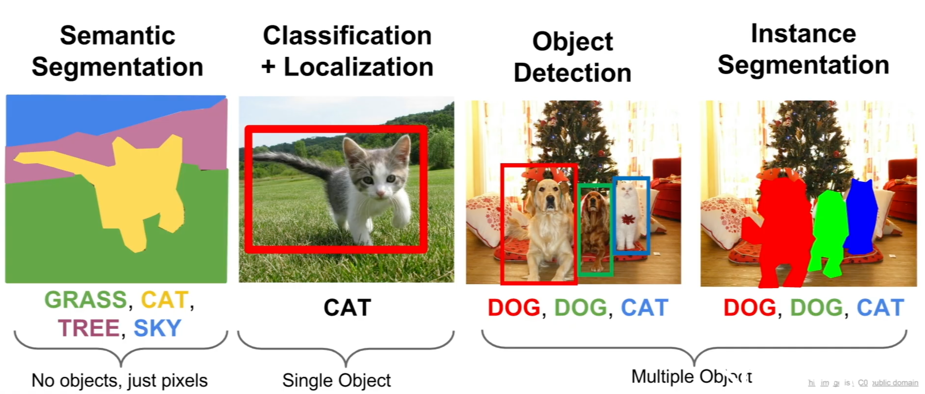

Slide 4
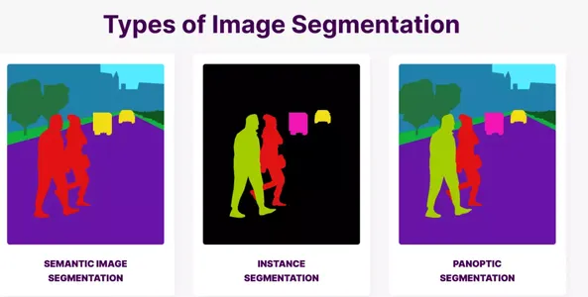
Segmentation

Slide 5
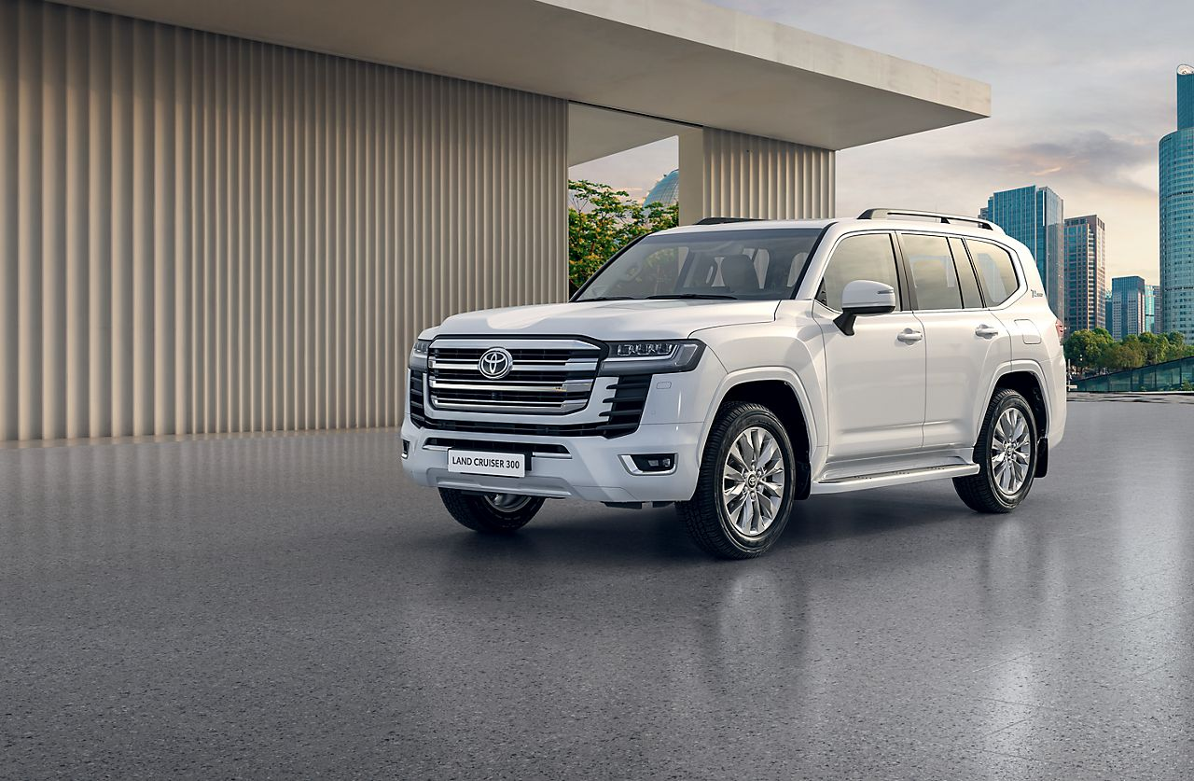
Semantic segmentation opportunities
Classify based on the middle pixel of a window

Slide 6
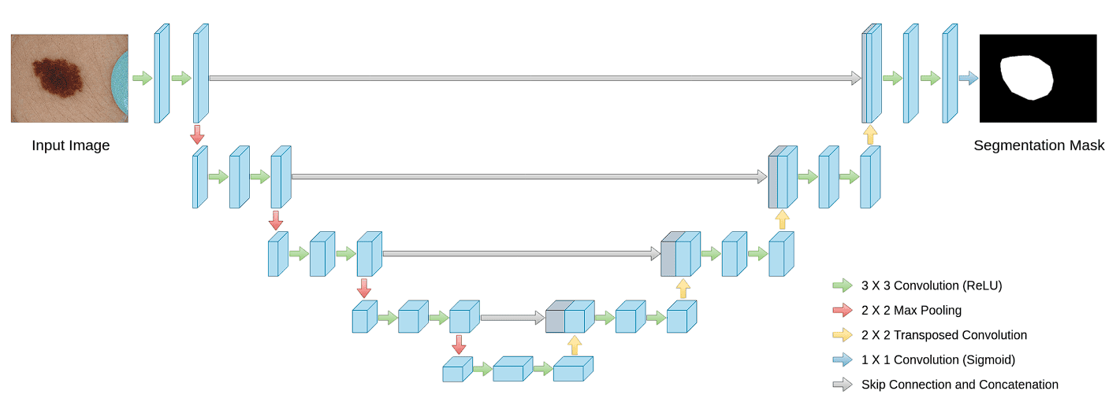
Segmentation architecture

Slide 7
Classification + localization
The goal is to output two things: the object's class (e.g., "cat") and its location as a single bounding box (e.g., 4 numbers: x, y, width, height).

Slide 8
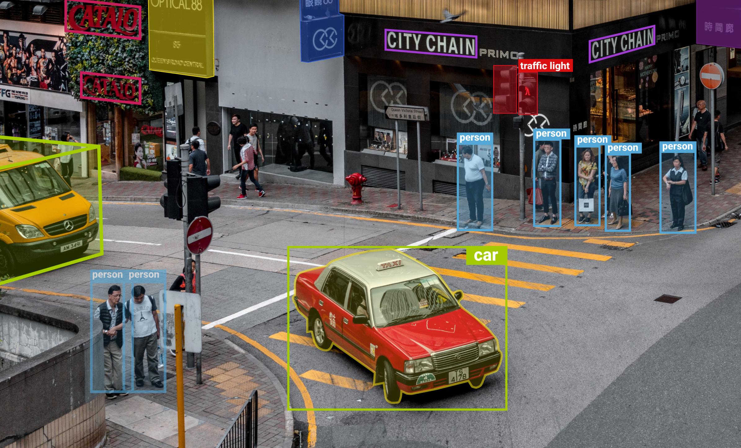
Yolo algorithms

